Slide 1
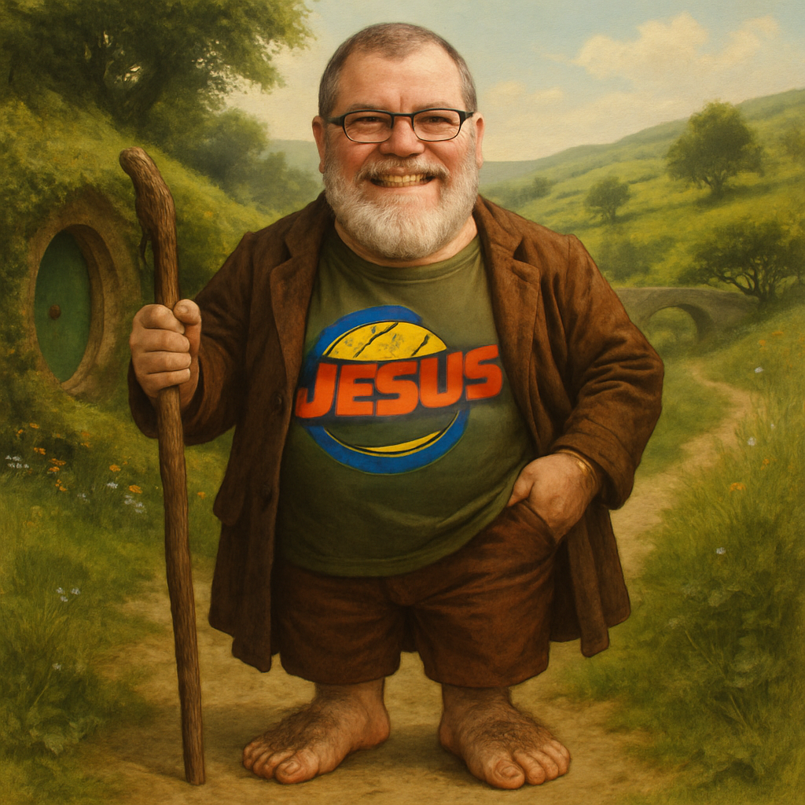
Why is the Resurrection Essential?
Every Christian should leave their comfort zone, a Hobbit’s Tale

Slide 2
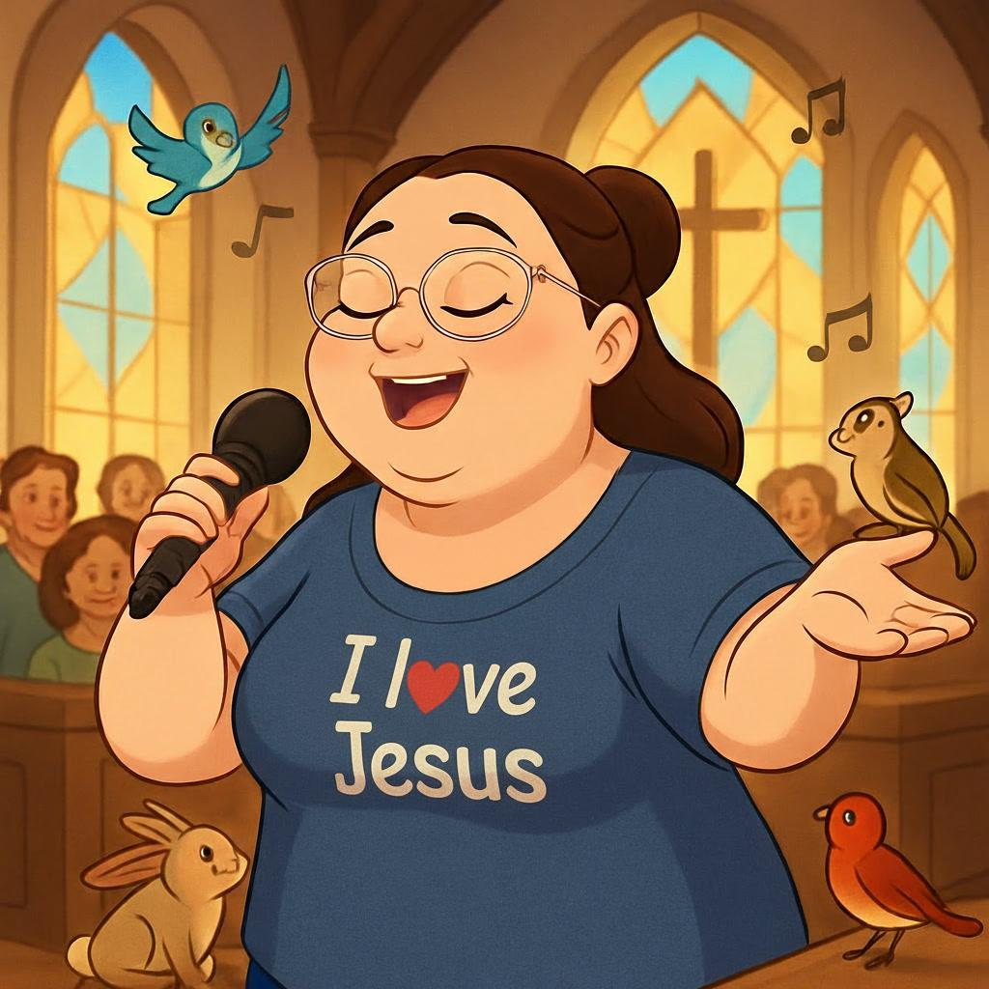

Slide 3
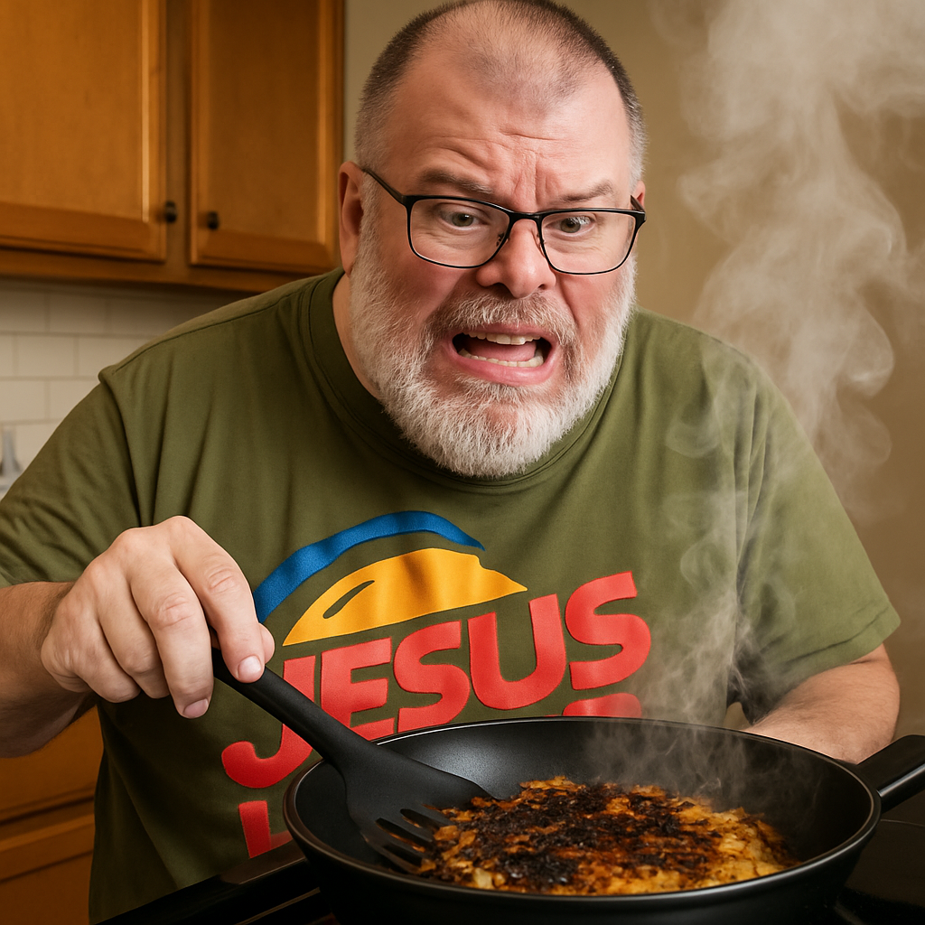
[if you know, you know]

Slide 4
[Slide 1]
God teaches us more from the journey than just the lesson we learn at the end.
Part of that lesson is allowing yourself to be humbled and submit to what God wants to teach you.

Slide 5
1 Corinthians 15:12-14 (ESV)
Now if Christ is proclaimed as raised from the dead, how can some of you say that there is no resurrection of the dead?
But if there is no resurrection of the dead, then not even Christ has been raised.
And if Christ has not been raised, then our preaching is in vain and your faith is in vain.
[Slide 2]

Slide 6

[Slide 3]
Paul had gone to a city named Corinth. He shared the Gospel, evangelizing and telling them about Jesus. After a year and some months, he felt they were in a good spot, the church was established, so he moved on.

Slide 7
There were instances where other teachers had come into town, Peter the Apostle and Apollos, which caused favoritism to develop. Some people were like “We like Paul better!” while others were like “We like Apollos or Peter better!”
[Slide 4]

Slide 8
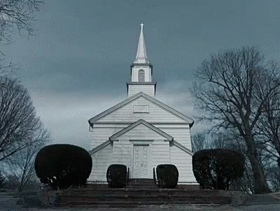
[Slide 5]
This caused a divide in the church. The people of the church started arguing about topics like circumcision, spiritual gifts, marriage, food that was offered to idols, and the resurrection.

Slide 9

[Slide 6]
When Paul heard about these issues, some of which is described in Acts 18, he wrote this letter to the church and its congregation. In this letter, you have Paul making a very strong statement concerning the resurrection, “If Christ has not been raised, then our preaching is in vain, and our faith is in vain!”

Slide 10
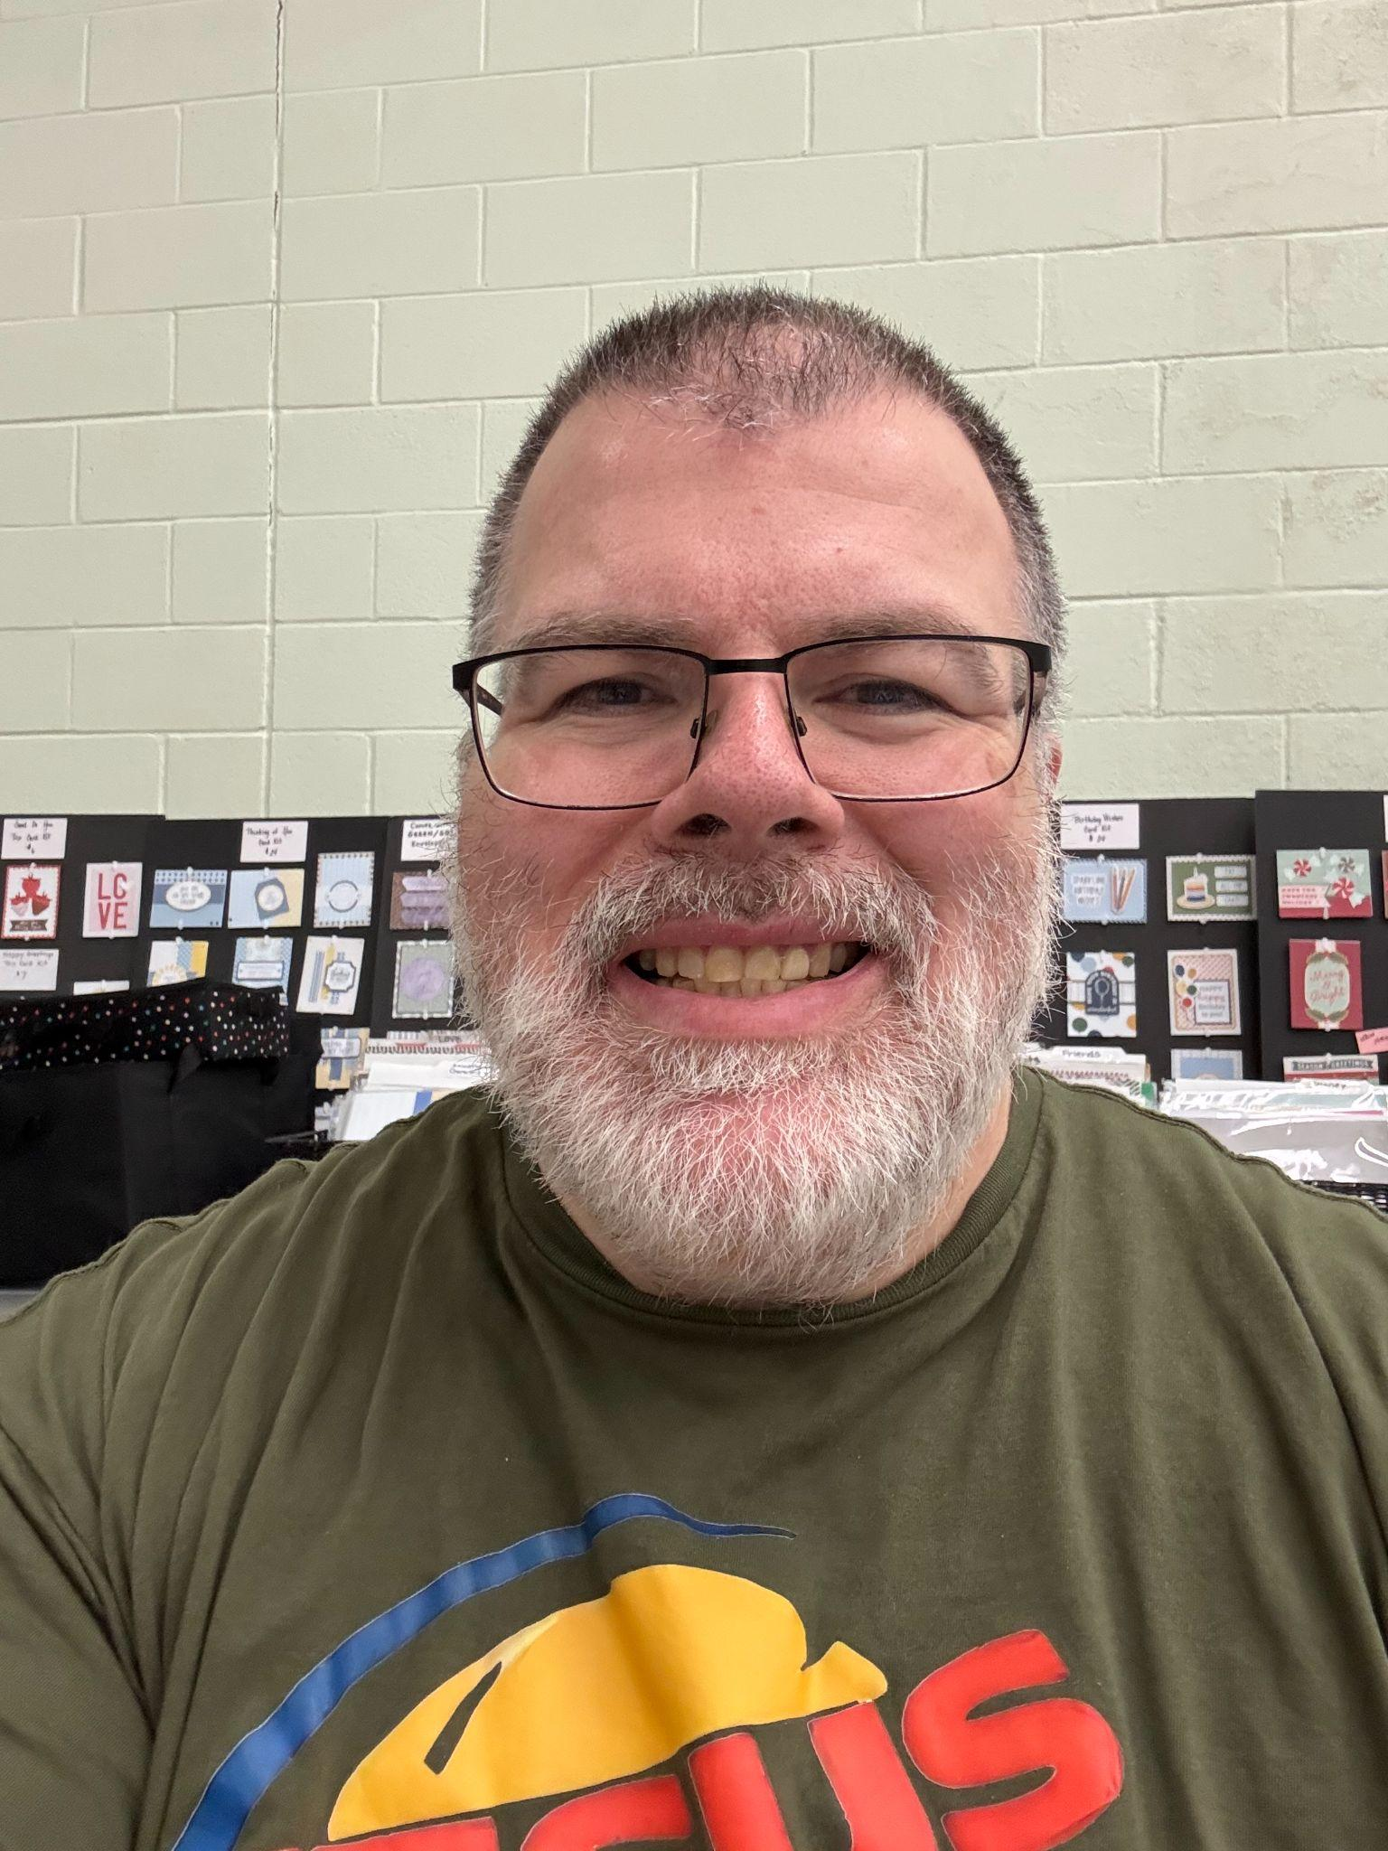

Slide 12
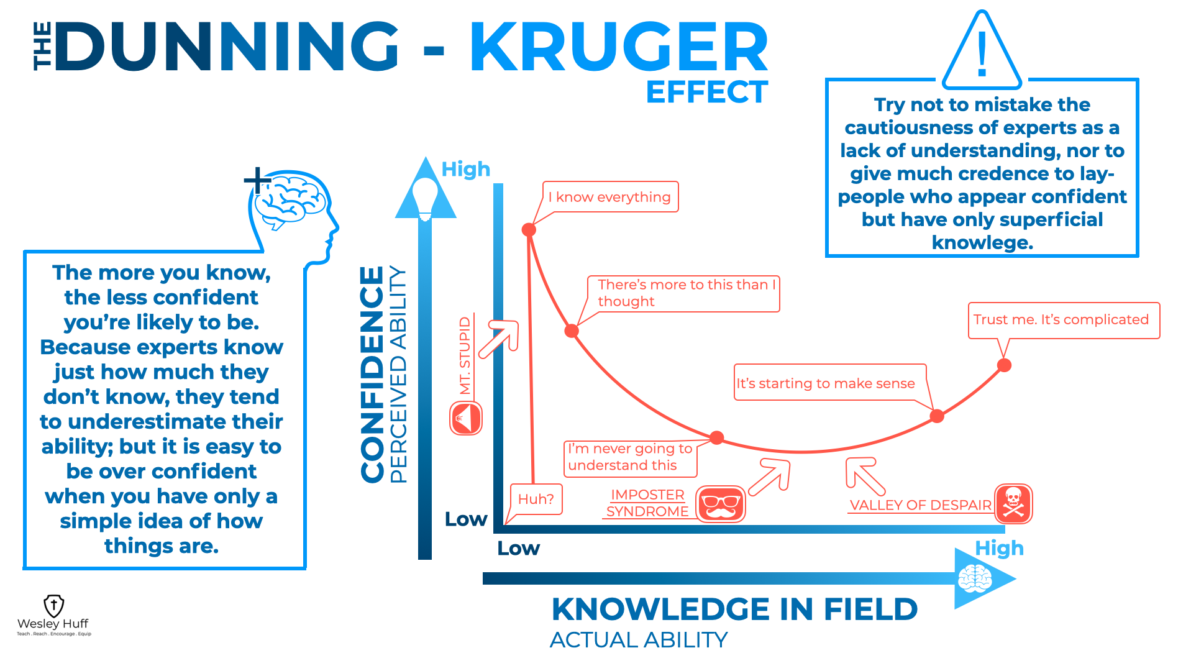

Slide 13
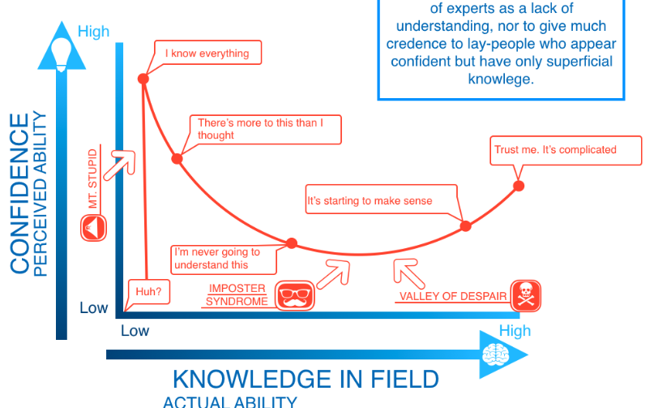
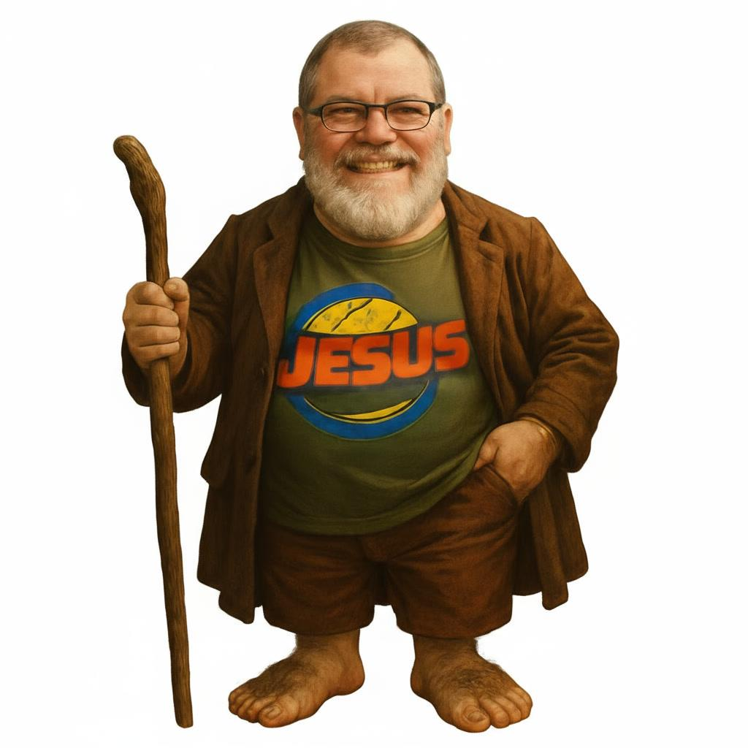

Slide 15

God is real.
God is the standard of goodness and morality.
God is Just, and because He is Just, my sin brings with it a debt I cannot pay.
Jesus paid that debt so I may have life!
[Slide 8]

Slide 17
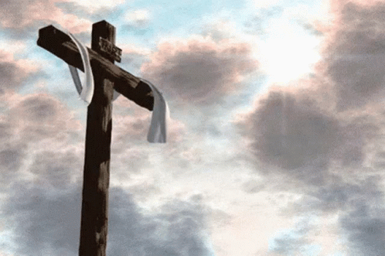
[Slide 9]
Looking into Jesus’ death on the Cross and the payment for our sins, it is easy to get into a pattern of giving answers without fully thinking them through. As someone would ask me about sin, I could relate it to God and how Sin was “missing the mark.”
Romans 3:23 tells us, “for all have sinned and fall short of the glory of God.”

Slide 18
I could explain that the debt for sin against an eternal God is death, and it was Jesus who paid that debt so we could go to Heaven.
Romans 6:23 tells us, “For the wages of sin is death, but the free gift of God is eternal life in Christ Jesus our Lord.”
[Slide 10]

Slide 19

Jesus, the Son, second person of the Trinity, came down, was born of a virgin, and took the punishment we deserve … I got all that, but why was it important he came back 3 days later?
[Slide 11]

Slide 20
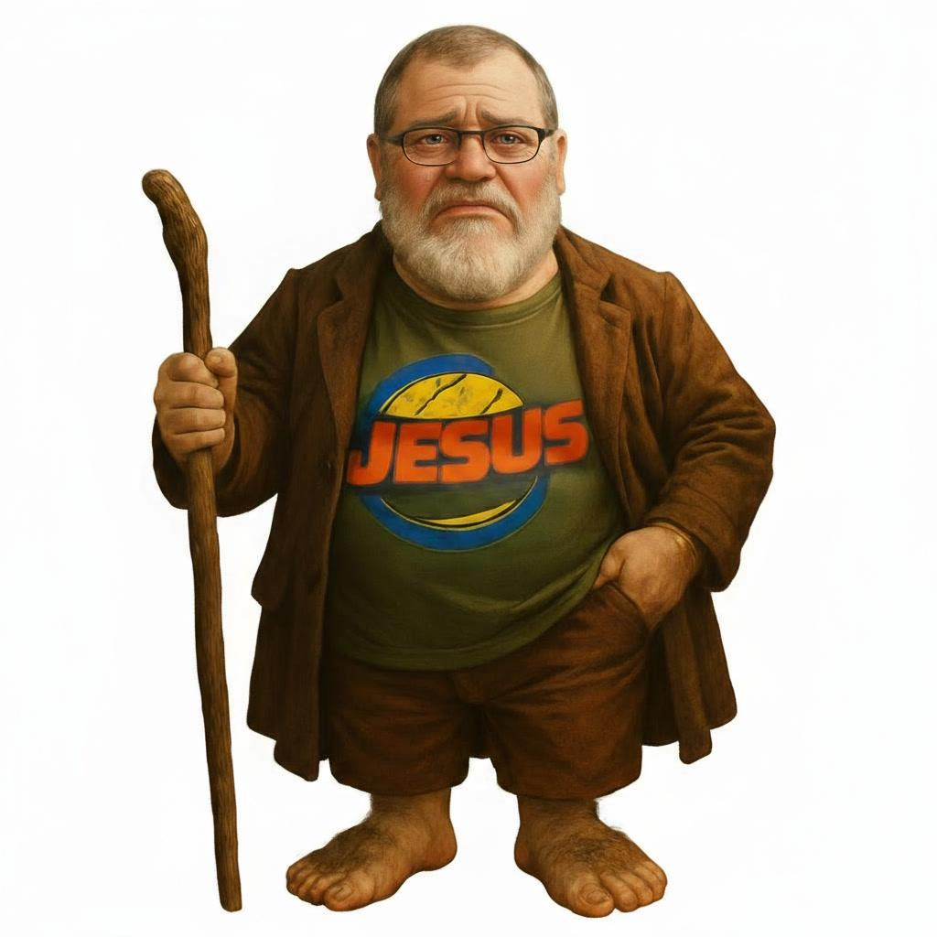

Slide 21
Paul is saying if Christ was not risen, my faith was in vain, and here I am not knowing the answer to a question I should know the answer to! If I do not have the answer, what does that say about my faith? What an enjoyable learning experience!
[Slide 12]

Slide 22
Here is the GOOD NEWS God helped me realize after that moment of despair …
1. I am never going to have all the answers, and that is OK.
2. No matter how much I think I know, I know WAY less than what I think, and that is OK.
3. And most important of all, I’m not JUSTIFIED by my ability to understand it all.
4. I’m JUSTIFIED by Christ and Christ alone.
5. My Salvation comes from my faith in Christ and His completed work on the Cross, apart from my understanding on every little aspect of theology, apart from my ability to answer questions people have, and apart from any work I can or cannot do.
6. That fact is what gives me assurance.
[Slide 13]

Slide 24
God is LORD over death AND over life!
1. 1 Samuel 2:6 tells us, “The LORD kills and brings to life; He brings down to Shoel and raises up.”
2. Deuteronomy 32:39 tells us, “See now that I, even I, am He, and there is NO God besides Me; I kill and I make alive; I wound and I heal; and there is none that can deliver out of my hand.”
3. And Revelation 1:17-18 tells us, “When I saw him, I fell at His feet as though dead. But He laid His right hand on me, saying, ‘Fear not, I am the first and the last, and the LIVING ONE. I died and behold, I am alive forevermore! And I have the keys of Death and Hades!”
[Slide 14]

Slide 25
Let’s take a moment to dive into Revelation 1:17-18.
Who is the one who saw and fell as though he was dead?
That was the Apostle John.
And who did John see, ALIVE, and who has the keys of death?
Our Lord, Jesus Christ.
[Slide 15]

Slide 26
What we have in the Bible is God’s revealed Word to us, and God’s Word is Truth.
If Christ would have remained dead, then we cannot trust the Bible.
If Christ would have remained dead, we would have no affirmation of Revelation 1.
If Christ was still dead, He would not be LORD over LIFE AND DEATH.
We CAN have faith and we CAN know that we will have eternal life because we have a LIVING GOD who is LORD over LIFE and over DEATH.
[Slide 16]

Slide 27


